Slide 1
ONLINE SYSTEM FOR DBU CONTINUING AND DISTANCE EDUCATION

Slide 2
FULL NAME………….………………………………. ID NUMBER
TEKLAY TEKLU….………………………….…..Compr/137/03
ALEMU ENDALE……………...………………..Compr/104/03
TESFA ADAMU………………………………….Compr/091/03
YARED DINKU…………………………………..Compr/097/03
DIRB WORKU……………………………………Compr/067/03

Slide 3
Presentation outline
Project title
Introduction
Objective of the project
A) General objectives
B) Specific objective
Scope of the project
Functional requirement

Slide 4
Use-case diagram
Conceptual class diagram
Design of class diagram
Database design
Component diagram
Development diagram

Slide 5
Introduction
What is online distance education?
The ability of teaching and learning process without going to university, college and so on
Teachers and administrators want the teaching learning process to be easy, exciting and effective.
Allow educational institutions to utilize databases applications such as online registration, online uploading reading materials and post updated information thus making the accessing of records centralized.

Slide 6
1.5.1 General objectives
The general objective of this project is to develop interactive web-based system in order to overcome the problems some subsystems with the existing system.
1.5.2 Specific objectives
To minimize work complexity of the existing system
To minimize cost of copying or duplicating materials
To reduce wastage of time to submit assignments
To enable new applicants online applying

Slide 7
1.7 Scope of the project
Providing tutorial online
Online examination
Online video learning
Online registration and payment
Distributing module via the internet
Distributing assignments for distance learners

Slide 8
2.10.1 Functional Requirements
Login into the system; authorized user can login the system
Manage user’s account including creating and updating
Uploading modules and assignments; enable an administrator upload module and assignment questions as well as download assignment answers submitted by students.
Downloading modules and assignments; enable student to download module and download assignment questions.
Post updated information; for students such information is, registration date, changed policies in the distance education etc.
Online application to be registered

Slide 9
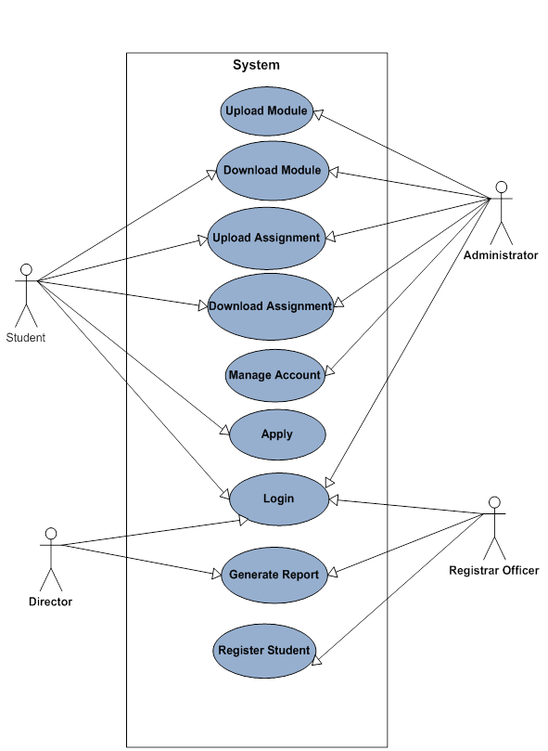
3.2.2 Use-case identification

Slide 10
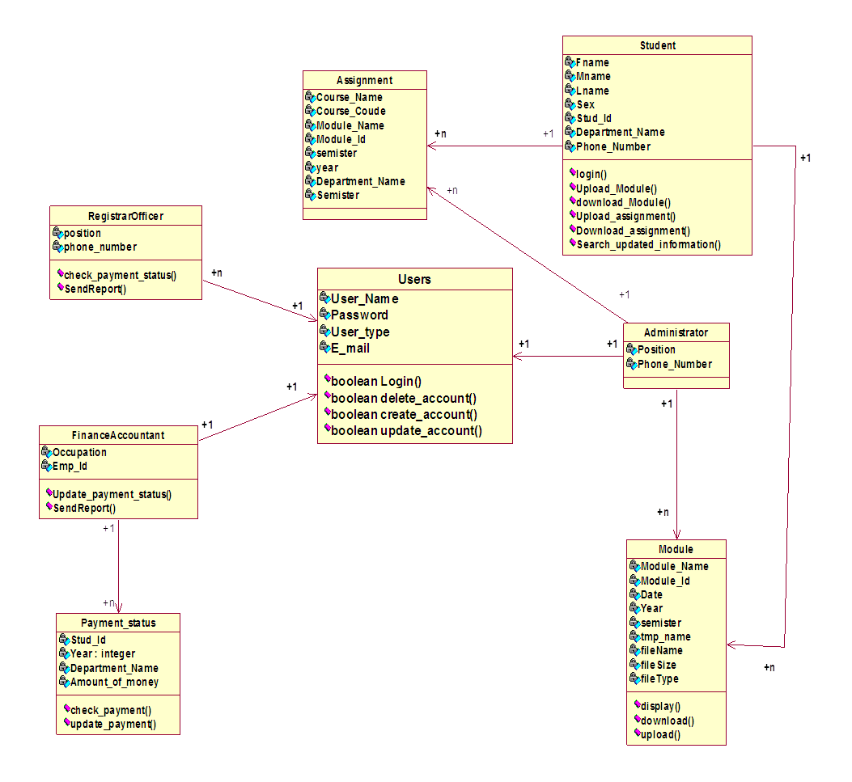
3.3 Conceptual Class diagram

Slide 11
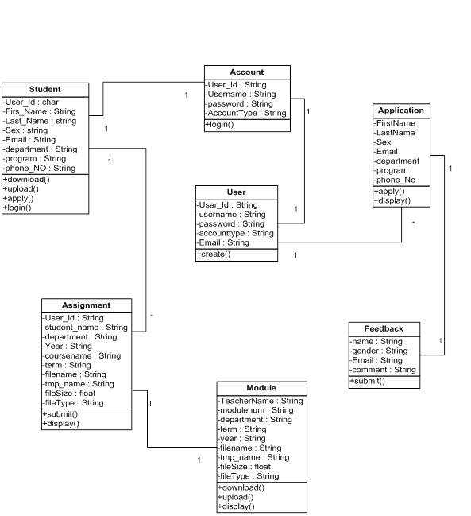
4.3 Design of class diagram

Slide 12
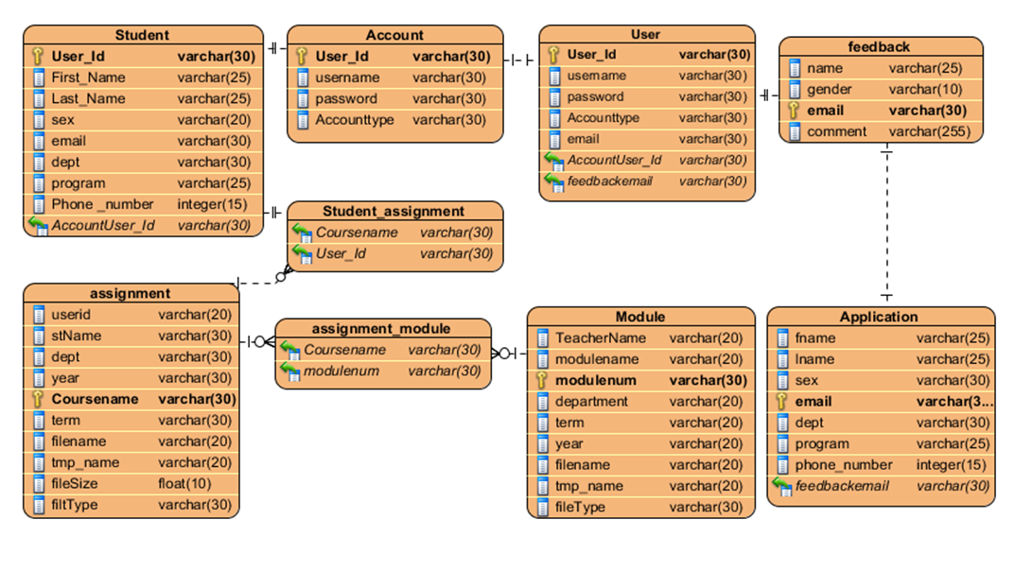
4.6 Database design

Slide 13
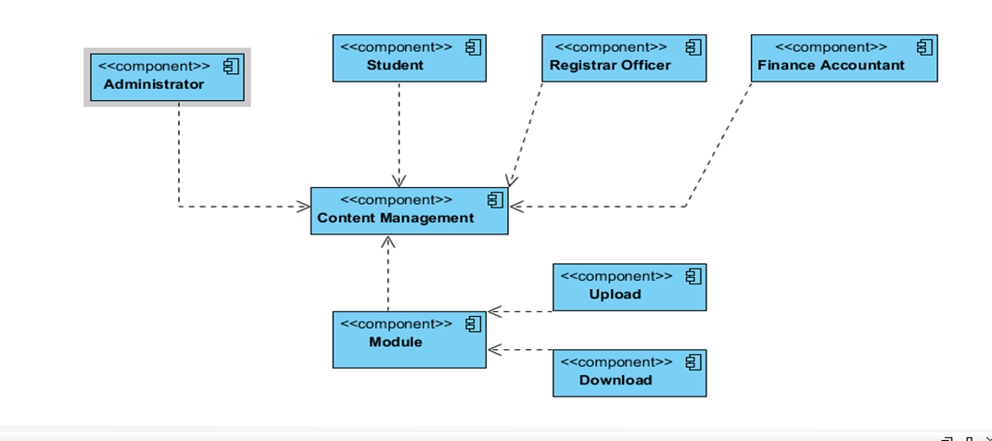
5.2 Component diagram

Slide 14
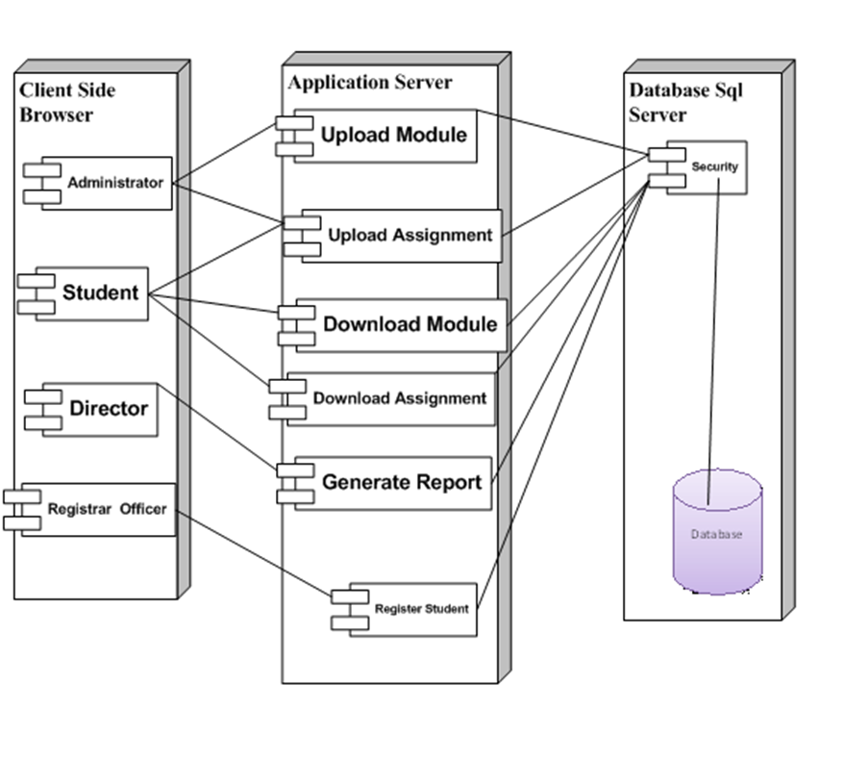
5.3 Deployment diagram

Slide 15
The End
Thank you !!

